Slide 1

AGILE METHODOLOGY

Slide 2
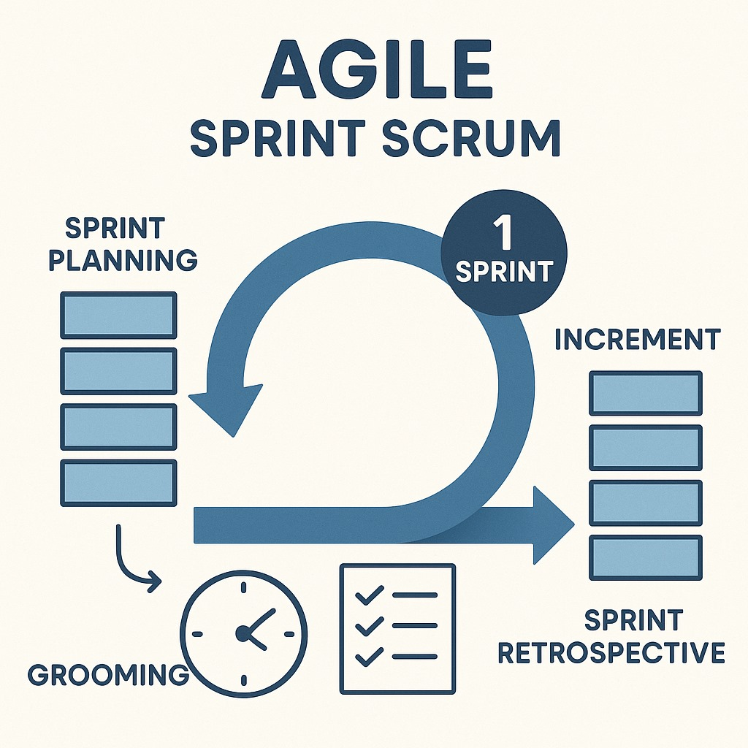
Table of Contents
Introduction to Agile Methodology
Roles in Agile
Scrum Master
JIRA
Sprint Grooming (Backlog Refinement)
Sprint Planning
Sprint Retrospective

Slide 3
Agile Methodology in Software Development
Agile is an iterative development methodology that emphasizes collaboration, adaptability, and rapid delivery.
Key Principles in Agile:
Customer Satisfaction through early and continuous delivery
Embracing Change and Adaptability
Continuous improvement through regular feedback
Benefits of Agile Methodology:
Faster time-to-market
Enhanced product quality
Reduced project risks

Slide 4
Roles and Responsibilities
Scrum Master: Facilitates Agile ceremonies and removes blockers for the team.
Developer: Builds and delivers working features from the product backlog.
Delivery Manager: Ensures timely project delivery by coordinating scope, time, and resources.
Technical Developer: Designs and guides technical architecture and solves complex coding issues.
DB (Database Engineer): Manages database structure and performance.
BA (Business Analyst): Gathers requirements and translates business needs into user stories.
QA (Quality Analyst): Tests the product to ensure quality and reports bugs.

Slide 5
Scrum Master
Facilitates daily stand-ups, sprint planning, reviews, and retrospectives.
Removes impediments/blockers for the team.
Ensures Scrum principles are followed.
Acts as a servant-leader and coach for the team.

Slide 6
JIRA
JIRA is a powerful tool for tracking progress, managing tasks, and enhancing team collaboration.
It supports Agile teams by organizing work into manageable sprints.

Slide 7
Sprint Grooming (Backlog Refinement)
Break down large user stories into manageable tasks
Prioritize and update backlog items
Break down large user stories into manageable tasks
Estimate effort for new stories

Slide 8
Sprint Planning
Define the sprint goal
Select prioritized backlog items
Estimate effort and commit to deliverables

Slide 9
Sprint Retrospective
Identify areas for improvement
Reflect on the sprint's outcomes
Identify areas for improvement
Define actionable next steps

Slide 10
Thank You

